Slide 1
Latches. Flip-Flops.
Remember the state. Bistable elements.
RS NOR latch
RS NAND latch
Clocked RS NAND latch
RS Flip-Flop
JK Flip-Flop
P&H Appendix-B
Wakerly Ch.7

Slide 2
Remember the state
The output of combinational logic is fully defined by the current state of the inputs.
How the circuit can hold (remember) the signal ?
First Define the requirements for circuit:
It should have a state:
The state could be either 0 or 1.
Current state
Next state
Should be possibility to see or to use that state
Should be way to setup or to change the state

Slide 3
RS latch – bistable element
Define the behavior

Slide 4
RS-latch - creation

Slide 5
Simplified RS latch – RS NOR latch

Slide 6
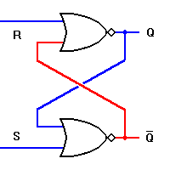
RS NOR latch analyze
S | R | Q | Qn
0 | 0 | Q | Q
0 | 1 | Q | 0
1 | 0 | Q | 1
1 | 1 | Q | X

Slide 7
RS NOR latch pros and cons
Forbidden to have both inputs at a logic 1 level at the same time
Input signals actively drive their respective outputs to a logic 0, rather than to a logic 1.
the S input signal is applied to the gate that produces the Q' output
while the R input signal is applied to the gate that produces the Q output.
This reversal of inputs can be confusing
The state is changed by the input signals level

Slide 8
RS NAND latch

Slide 9
RS NAND latch analyze

Slide 10
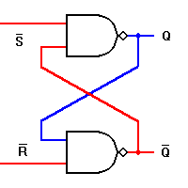
RS NAND latch timing diagram
S’ | R’ | Q | Qn
0 | 0 | Q | X
0 | 1 | Q | 1
1 | 0 | Q | 0
1 | 1 | Q | Q

Slide 11
RS basic NAND latch cons and pros
Forbidden to have both inputs at a logic 0 level at the same time
The problem with the basic RS NAND latch is that the active input levels are Zeroes.
We need extra invertors to make the active levels to Ones.
The state is changed by the input signals level

Slide 12
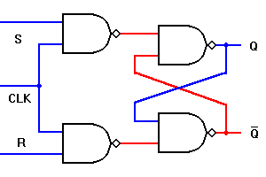
The Clocked (gated) RS NAND latch
normal rather than inverted inputs
and a third input common to both gates which we can use to synchronize his circuit with others of its kind.
CLK | S | R | Q | Qn
0 | X | X | Q | Q
1 | 0 | 1 | Q | 0
1 | 1 | 0 | Q | 1
1 | 1 | 1 | Q | X

Slide 13
Clocked RS NAND latch drawbacks
If both inputs are logic 1 when the clock is also logic 1, the latching action is bypassed and both outputs will go to logic 1.
A major problem remaining is that this latch circuit could easily experience a change in S and R input levels while the CLK input is still at a logic 1 level.
This allows the circuit to change state many times before the CLK input returns to logic 0.

